Slide 1
Professional vacationing unlimited
Round 2

Slide 2
Get Connected
Become a “Pro” and create a free account today
Get Involved
Choose a Category
Professional
Guides, Coaches, Experts
Vacationing
Stories/Tips, Pictures, Videos
Unlimited
Requests, Offers
Get Inspired
Begin Vacation Today

Slide 3
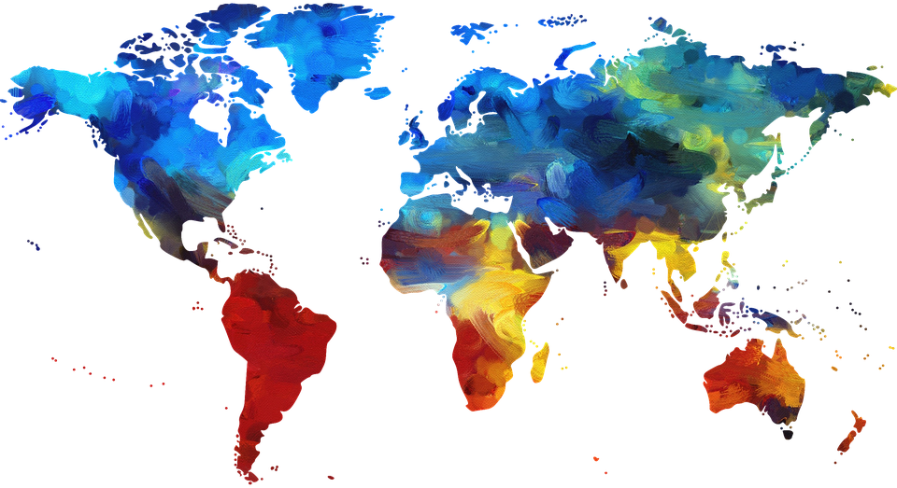
Get connected
Create Free “Procationer” Account
Name
Email
Birthdate (18+)
Gender
Profile Pic
Bio
Albums
Itineraries, Stories, Pics, Vids

Slide 4
Professional
Vacation Guides-Free
Vacation Coaches-Fee
Vacation Experts-Fee
Link with PVU approved guides for you next trip
Use premade PVU itineraries
Provides links to accommodation and flight booking
Provides links for rental gear and equipment during your vacation
General advice advice for areas within trip
Extra fee to bring PVU Coach or Expert along with on trip
Access to PVU’s itinerary generator-fee?
Have a PVU coach draw up and help execute your next vacation
Creates custom itinerary based on personal preferences to best suit your needs
Provides direct specific tips, advice, and help for entire vacation
Provides information on what to pack and expect on your next vacation
Schedules flights, accommodations, and other bookings/rentals
Provides all services as coach
Provides services in multiple languages
Helps acquire visas, passports, and travel insurance
Provides a budget to meet your next vacation needs
Provides *hidden gems* not in regular PVU itineraries (coach?)
Only available for PVU itineraries?

Slide 5
Vacationing
Post and view personal vacationing
Tips/trips/stories, pictures, and short videos
Links to your profile
Tag places, events, activities, itineraries, responses to requests etc
Earn points for posting to be used towards PVU gear, services, and various prizes
Be nominated for tip of the day, pic of the day, and vid of the day
Highlighted on procationers, Instagram, snapchat, facebook

Slide 6
Unlimited
View or post offerings, requests, plans for vacation related activities
Share travel plans, offer to join and request to join
Link to profiles
Short term and seasonal jobs
Translators
Guides
Information of specific areas
Link to tips/stories, pics, vids

Slide 7
Begin vacation
Spin the Globe
Take a Survey
Create Itinerary-Fee
Choose your start point and time of year for your vacation
Spin the globe
Explore a random location itinerary created by PVU
Plan your vacation by adding flights, accommodation, transportation
Use guide tools
Add a coach, expert
Filters
Budget
Survey displays custom itinerary best suited to your answers
Questions include
Time of year
Length of vacation
Type of vacation
Sand and Sea, Mountains,
Activities prompted by type of vacation
Diving, skiing/snowboarding, R&R, sightseeing, hiking, climbing,
Start to prepare for your vacation
Use guide tools
Add a coach, expert
Create you own custom itinerary
Choose time of year
Select on map your destination area
Select from various activities provided from PVU
Activity cost estimator included
Plan your vacation by adding flights, accommodation, transportation,
Use guide tools
Add a coach expert

